Slide 1
REPORTING VERBS
&
PASSIVE REPORTING VERBS

Slide 2
VERB + TO + INFINITIVE
Agree
Offer
Promise
Refuse
Swear
Threaten
Claim

Slide 3
VERB + TO + INFINITIVE
“Jack offered to take a photograph of me”
“I refused to leave the building”
“He swore to tell the truth”

Slide 4
VERB + OBJECT + TO + INFINITIVE
Advise
Ask
Beg
Convince
Encourage
Invite
Persuade
Recommend
Urge
warn

Slide 5
VERB + OBJECT + TO + INFINITIVE
“Julia asked me to drive her to the airport”
“I don’t like concerts but Max convinced me to come”

Slide 6
VERB + -ING
Admit
Deny
Recommend
Suggest

Slide 7
VERB + -ING
“They denied taking the money”
“Luke suggested going to the park”

Slide 8
VERB + PREPOSITION + -ING
Apologize for
Complain about
Confess to
Insist on
Object to

Slide 9
VERB + PREPOSITION + -ING
“You should apologize for being so rude”
Sara insisted on eating at home”

Slide 10
VERB + OBJECT + PREPOSITION + -ING
Acusse…of
Blame…for
criticise…for
Congratulate…on
Praise…for
Thank…for

Slide 11
VERB + OBJECT + PREPOSITION + -ING
“Anna always accuses me of being lazy”
“Lars praised his son for winning the competition”

Slide 12
*When we use reporting verb we often have to make changes to pronouns, time
expressions, etc.
“You have broken my phone” “She blamed me for breaking his phone”
“I will be back tomorrow” “She promised to be back the next day”
*Some reporting verbs can also be followed by that + clause. When we use a reporting verb + that, we often make change to the tense.
“We will be late” “I warned you that we would be late”

Slide 13
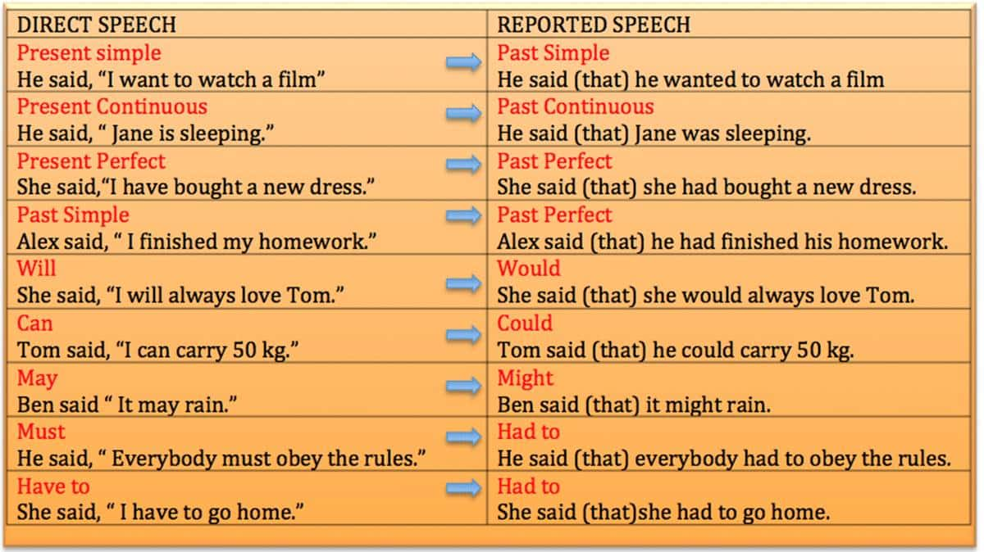

Slide 14
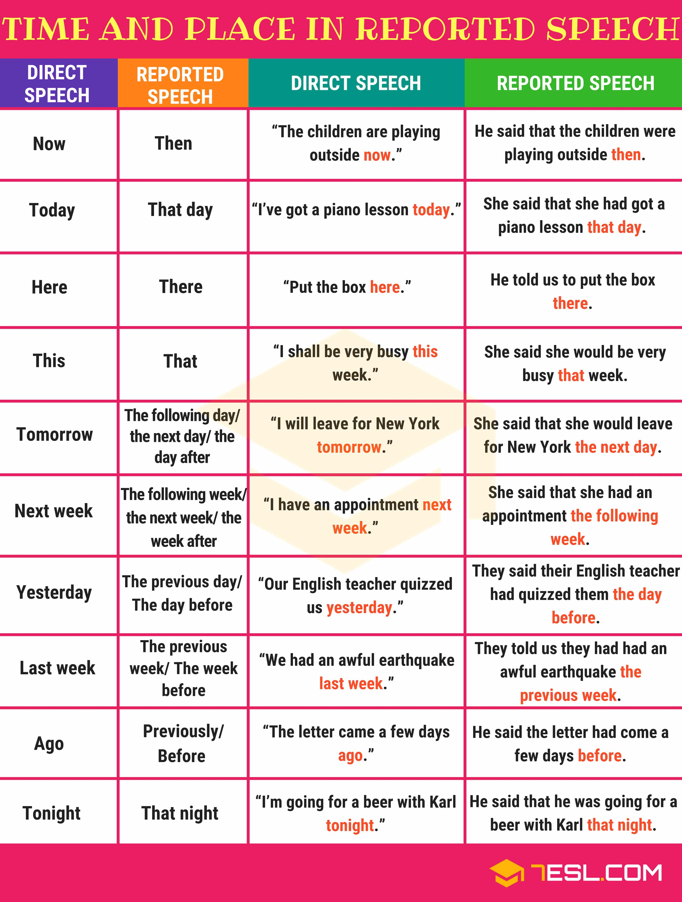

Slide 15
PASSIVE REPORTING VERBS
We often use passive reporting verbs to report feelings, beliefs, opinions and rumours,
especially in journalism or other formal contexts. We often do this when we don’t know or
don’t want to say who made the statement.
THERE ARE TWO PATTERNS:
It + passive verb + that + subject
“It is thought that the Prime Minister will make an important announcement later today”
Subject + passive verb + infinitive
“A man aged 95 is reported to be a lottery winner for the third time”
*We commonly use the following verbs with both patterns: believe, confirm, expect,
know, report, say, think and understand.

Slide 16
PASSIVE REPORTING VERBS
To report a past action (present perfect or past simple) with the second pattern, we
use a perfect invinitive (an infinitive form with have + past participle).
“Three people are said to have been rescued from a house fire”
To report an action in the future or in progress now with the second papttern, we use
a continuous ifinitive (be + -ing form).
“The company is said to be looking for anew manager”

